Slide 1
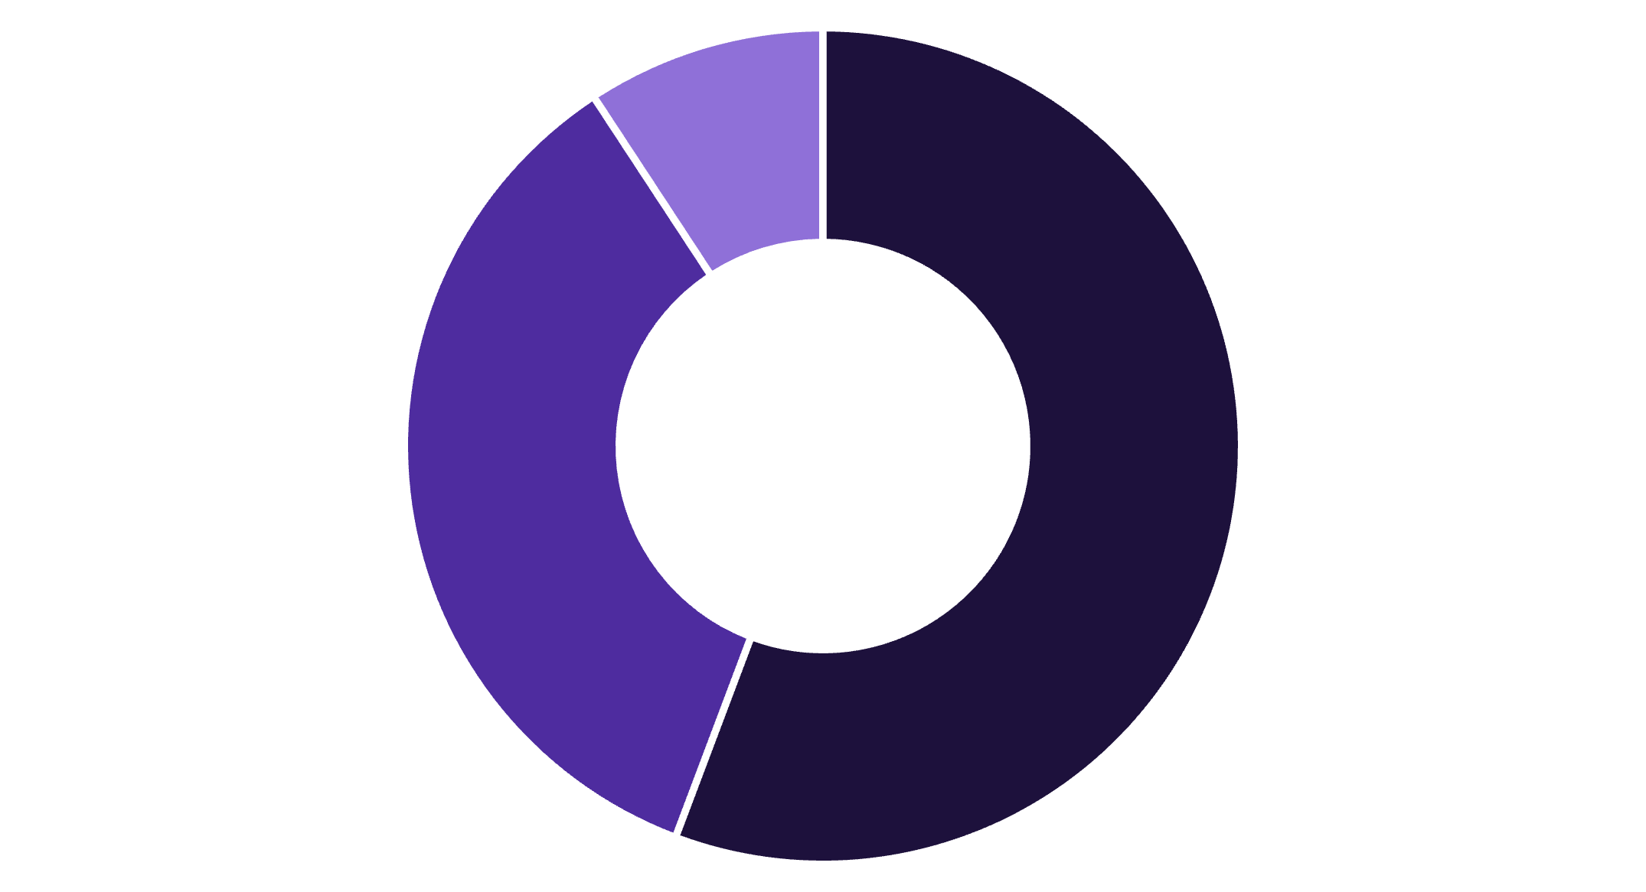
Databricks Apps Governance
Phase 2 & 3 Implementation Update
Building on our successful Phase 1 foundation, we're advancing our governance framework with enhanced monitoring capabilities and proactive cost management strategies.
Phase1 Complete ✅
Phase 2 Complete ✅ (current sprint)
Automated Databricks App permissions
Enhanced monitoring and apps limitation per user
Once app created Automatically Add SP to the Databricks Group.
Weekly Total Apps Status notification
Databricks group has all the required permissions.
3-apps per user limitation enforcement
— model serving endpoints
Weekend Apps Shutdown for cost optimization
— Secret Scope
— SQL WareHouse
— common Datasets ,
Phase 3 Planned 🔜 (next sprint)
Automated cleanup and comprehensive user communication
Inactive app deletion automation
Governance activation notifications
Complete feature rollout communication
Weekly Databricks Apps Status Dashboard
Deployment Tracking
Success Rate: 94.2%
Successful deployments: 267
Failed deployments: 17
No active deployments: 45
Our monitoring system now provides real-time visibility into app health and deployment success rates across all workspaces.
Active
Stopped
Error State
Phase 2 Implementation Achievements
01
02
03
3-App User Limitation
Weekend Sandbox Optimization
Enhanced Status Monitoring
Successfully implemented workspace-level app limits. Users exceeding 3 apps receive automated notifications, with excess apps flagged for deletion approval.
Automated weekend shutdown of all sandbox apps reduces compute costs by an estimated 40% weekly, with automatic restart capabilities for Monday morning.
Weekly dashboard provides comprehensive visibility into app states, deployment success rates, and resource utilization patterns across all environments.
Phase 3 Roadmap
Inactive App Cleanup
Governance Activation Notice
Complete Feature Rollout
Automated identification and deletion of apps with no activity for 30+ days, with user notification and grace period
Comprehensive communication to all sandbox users about governance features and compliance requirements
Final implementation of all governance phases with full documentation.
Next Steps: Phase 3 implementation begins next sprint with inactive app deletion automation and comprehensive user notification campaign. Expected completion within 2 weeks.

